Slide 1
TN Med Helper Findings
Annika Faucon, Cong Wang, Jordan Anderson-Daniels, Prasad Kopparapu

Slide 2
Tennessee Counties of Concern
Which counties have the fewest primary care physicians?
Which counties have the fewest hospitals?
Which counties have the lowest life expectancy?

Slide 3
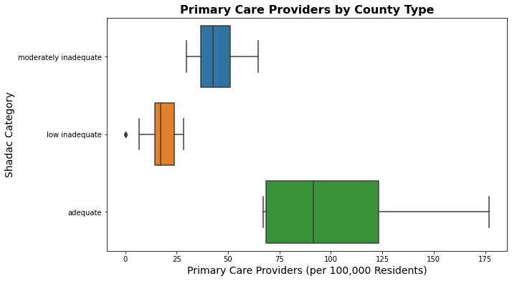
Counties of Concern: ”Low Inadequate”
1500-3500
>3500
<1500

Slide 4
31 ”Low Inadequate” TN Counties
Benton | Crocket | Hawkins | Humphreys | Macon | Perry | Van Buren
Bledsoe | Grainger | Haywood | Jackson | Marshall | Stewart
Cannon | Grundy | Henderson | Lake | Monroe | Tipton
Chester | Hancock | Hickman | Lauderdale | Moore | Trousdale
Clay | Hardeman | Houston | Lewis | Morgan | Union

Slide 5
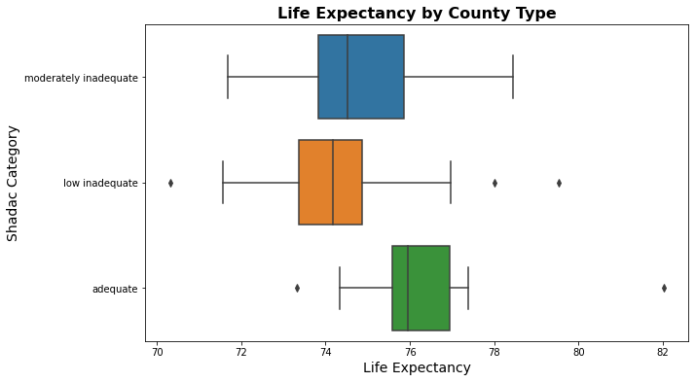
“Low Inadequate” counties have the lowest median life expectancies
1500-3500
>3500
<1500

Slide 6
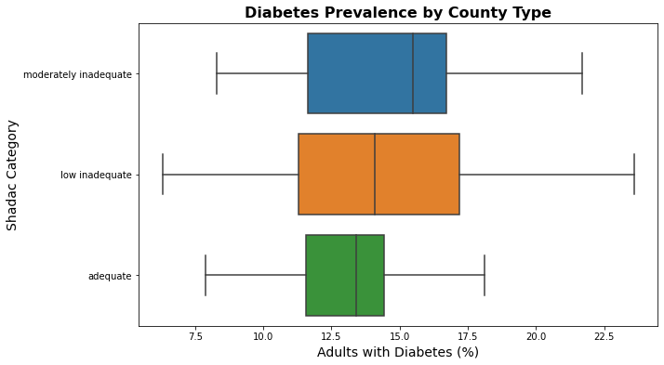
“Low Inadequate” counties have broad Diabetes Prevalence
1500-3500
>3500
<1500

Slide 7
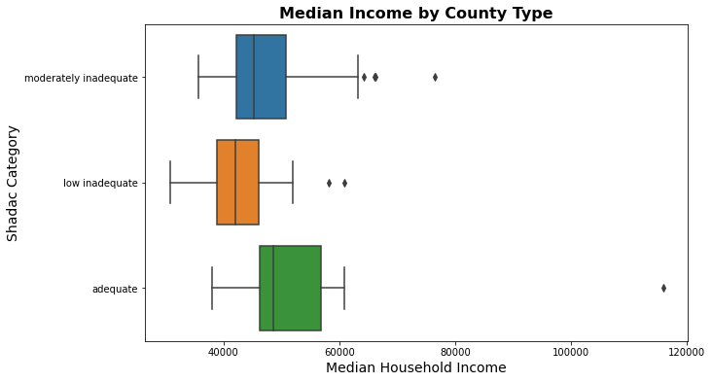
“Low Inadequate” Counties have lowest median household income
1500-3500
>3500
<1500

Slide 8
TN counties with no hospitals
Chester | Lewis | Van Buren
Crockett | Moore
Grainger | Morgan
Grundy | Stewart
Lake | Union

Slide 9
TN counties with no hospitals and no primary care providers
Lake
Crocket
Van Buren
Grundy
County | Life Expectancy | Adults with Diabetes (%) | Median Household Income | % Under 65
Crockett | 74 | 12 | 44431 | 81
Grundy | 72 | 24 | 36317 | 79
Lake | 73 | 11 | 33709 | 84
Van Buren | 74 | 14 | 38265 | 76

Slide 10
TN counties with no hospitals and no primary care providers
Lake
Crocket
Van Buren
Grundy
County | Life Expectancy | Adults with Diabetes (%) | Median Household Income | % Under 65
Crockett | 74 | 12 | 44431 | 81
Grundy | 72 | 24 | 36317 | 79
Lake | 73 | 11 | 33709 | 84
Van Buren | 74 | 14 | 38265 | 76

Slide 11
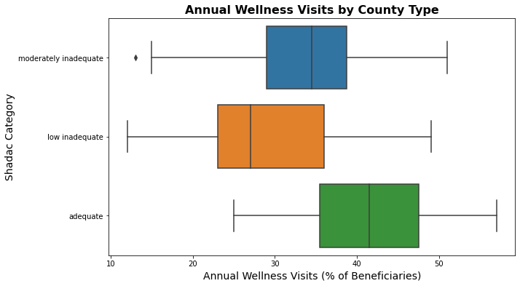
“Low Inadequate” counties tend to have the fewest Annual Wellness visits
1500-3500
>3500
<1500

Slide 12
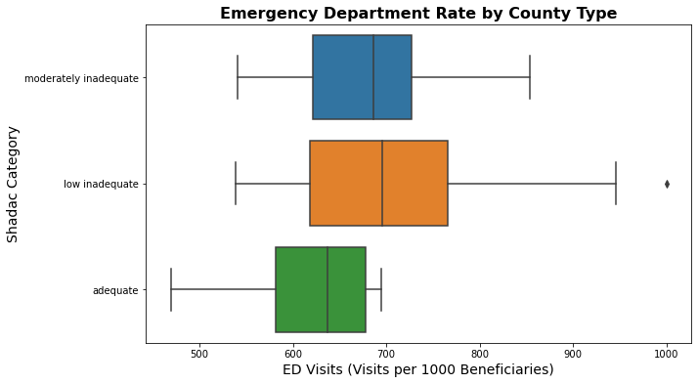
“Low Inadequate” counties tend to have more emergency department visits
1500-3500
>3500
<1500

Slide 13
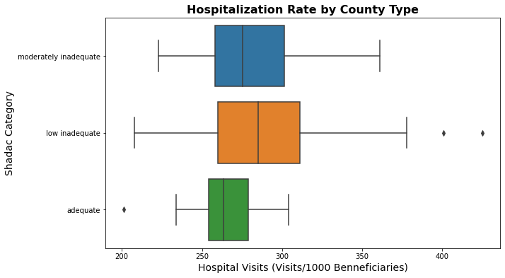
“Low Inadequate” counties tend to have more hospital visits
1500-3500
>3500
<1500

Slide 14
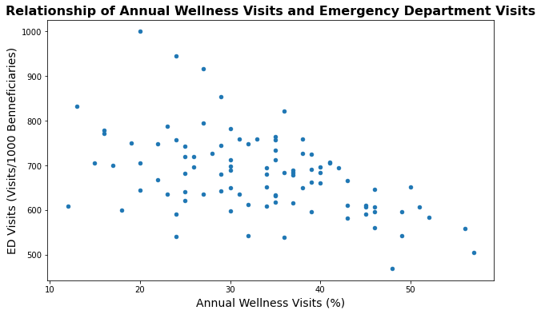
Fewer wellness visits correlates with more emergency department visits
Correlation: -0.48

Slide 15
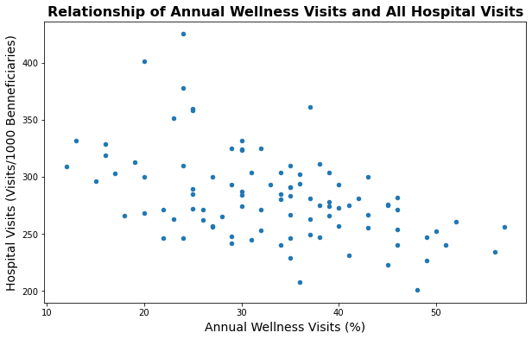
Fewer wellness visits correlates with more hospital visits
Correlation: -0.48

